Slide 1
Extragalactic Astrophysics and Cosmology Group Study 2013
Predictions Group Seminar

Slide 2
Our Aims:
To be able to predict the number of galaxies present during the epoch of Cosmic Reionization.
To calculate the number of UV photons available to re-ionize the neutral hydrogen in the IGM in order to obtain an estimate for the redshift range of this epoch.

Slide 3
How we have done this:
Found a general Schechter Function in terms of magnitudes.
Built a program to automate process of calculating number of galaxies using this Schechter Function.
Found plausible starting parameters.
Determined parameter evolution with time.
Incorporated most likely parameter evolution into program.
Determined how cosmic variance affects this numbers.
Incorporate cosmic variance and clustering into the program.
Plotted results to display data visually.
Give an estimate of number of galaxies to the observers.
9. Written separate program to obtain estimate of the number of UV photons available to ionize the neutral hydrogen in the IGM.
10. Used this number to estimate the redshift range for the epoch of Cosmic Reionization.

Slide 4
What else needs to go in:
Jamie: schechter function- what it is and why we used it (very brief).
Owen and Andy: briefly how the programs do this and why we have 2, initial results?
Josh: assumptions and parameters/ evolution with time- graph of different ones and which we have chosen (preferably on same plot?) and why.
Owen and Andy: how this changed results.
Lewis: cosmic variance and clustering- what they are and how they affect number of galaxies and briefly how to include it.
Owen and Andy: how cosmic variance affected results- quote results? Any graphs?
Jamie/ Beth: star formation rates, how we calculated, why we calculated, what limit does this put on the redshift? What numbers did we get for number of ionizing photons?
Beth: summary of final values: number of galaxies (include magnitude and redshift range for completeness) and number of ionizing photons and hence redshift range.
If we manage to work out this jeans mass for galaxies to form (I think that was Owen) then that will be included perhaps before star formation rates.

Slide 5

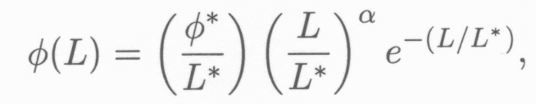

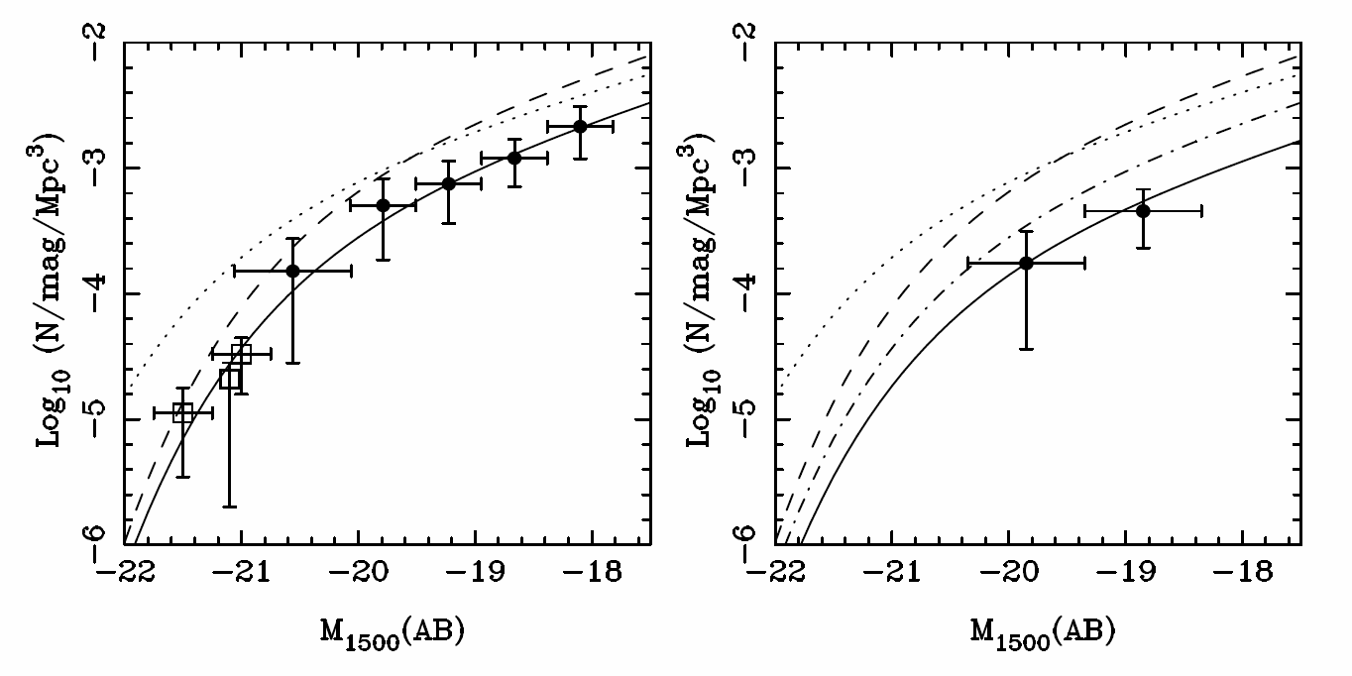
Schechter Function
Z=7
Z=8
(McLure, 2010)

Slide 6

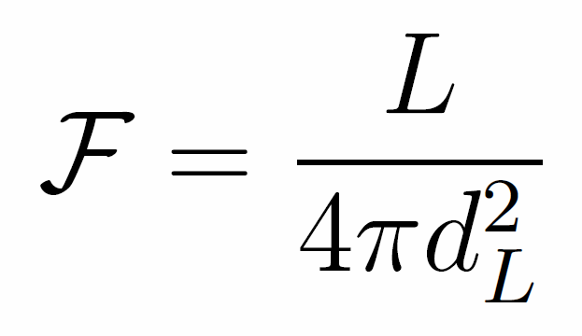
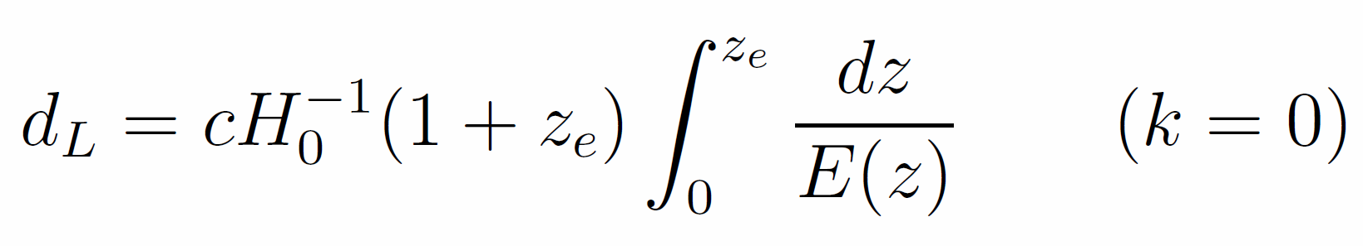
Co-moving Distance
Luminosity Distance
Magnitude Conversion
Notes:
dH (hubble distance) radius of the visible universe. Luminosity distance is redshifted. Magnitude conversion is for AB system.

Slide 7
Assumptions
Universe is:
Flat
Matter Dominated
No cosmic variance
Constant Schechter Function
Parameters of the Schechter function do not change as a function of redshift.

Slide 8
Schechter Function
Next step is to add variation in the parameters of the Schechter Equation as a function of redshift.
Involve using real data from observations
Extrapolate backwards for higher redshift
Try different fits for data.

Slide 9
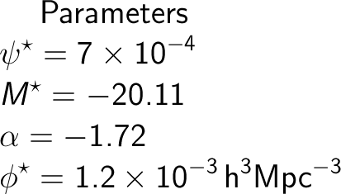
Parameters
Parameters taken from papers on high redshift galaxies.

Slide 10
Programs A. And B.
We have two programs computing the same quantities in slightly different ways in order to validate any results we obtain.
These have been mainly written by Owen and Andy.

Slide 11
Schechter Function Computation
Main aims: To give the observing group appropriate inputs, and to compare results with other code.
Results: Appropriately shaped Schechter function graph upon output, and a number of galaxies outputted, within apparent magnitude range.

Slide 12
Future Aims
Attempt to match outputted number with observed data at a variety of redshifts and apparent magnitudes
Get program to output effectively
Calculate Ionizing photon rate density from Schechter Function.
Integrate graphing function with code.
Parameters evolving with redshift.

Slide 13
Schechter function output

Slide 14
Plans for improvement
Converging time analysis to optimise accuracy for a given computation time.
Implement upper and lower bounds on parameter evolution
Output distributions
Create intuitive input system

Slide 15
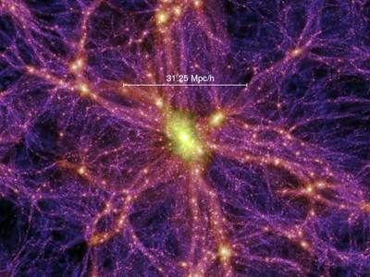

Cosmic Variance
Statistical uncertainty in any cosmological observation brought about by large-scale cosmic structure.
The Universe is only homogeneous at the largest scales (>1Gpc).
Any number or density measurement derived from a galaxy population is susceptible to Cosmic Variance.
This will be the dominant source of error, well in excess of Poisson noise.
Any cosmic survey should take account of Cosmic Variance.
Given by:

Slide 16
Including in the code
Any estimates produced for the observing team, from the code, should account for Cosmic Variance in some way.
The Cosmic Variance of a survey depends on:
Total survey volume.
Aspect ratio - lower for higher aspect ratio surveys.
Number of sightlines - empirically reduced with multiple sightlines, by √N – where N is the no. of sightlines.
We found an empirical formula for the Cosmic Variance for any galaxy survey, derived
using SDSS and extrapolated to higher redshifts.
Now, the program can give an estimate for Cosmic Variance for any survey the observers
choose to input/can give the appropriate N, asp rat etc. necessary to reduce Cosmic
Variance to below 10%.

Slide 17
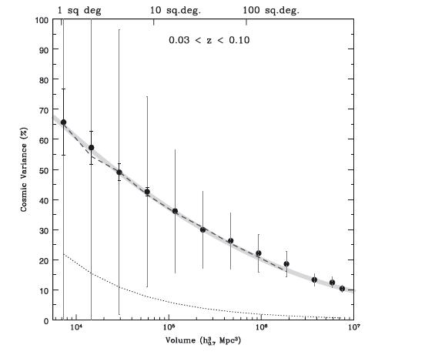
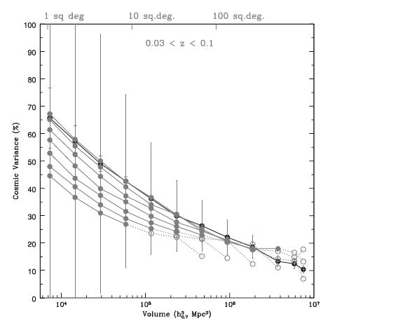

Slide 18


Clumping
Critical Star Formation Rate required to keep the Universe ionised heavily depends on the average rate of recombinations in the IGM.
This recombination rate is proportional to the clumping factor:
However, if C~10 or more, recombinations significantly delay the redshift at which we see reionization.
Any redshift limit we deduce should take clumping into account.
Critical Star Formation Rate density depends on redshift, clumping factor and escape fraction:

Slide 19
Summary:

